Slide 1
Churn Prediction
Lim Wan Ting
MLDDS05

Slide 2
Outline
Goal/objectives
Explore telco data to determine customer retention, based on details such as customer characteristics, spending, etc.
Data source
Sample dataset obtained online from IBM Watsons Analytics.
Output
Classify new customers into churn or non-churn based on their details

Slide 3
Pipeline
Data obtained (online source)
Data Engineering
Train Model
Neural Network
Feature engineering
Select Kbest
Train Model(s)
Neural Network
SVC
KNN
Decision Tree
Compare models and select best model
Conclusion

Slide 4
Data Engineering
(Jupyter Notebook)

Slide 5
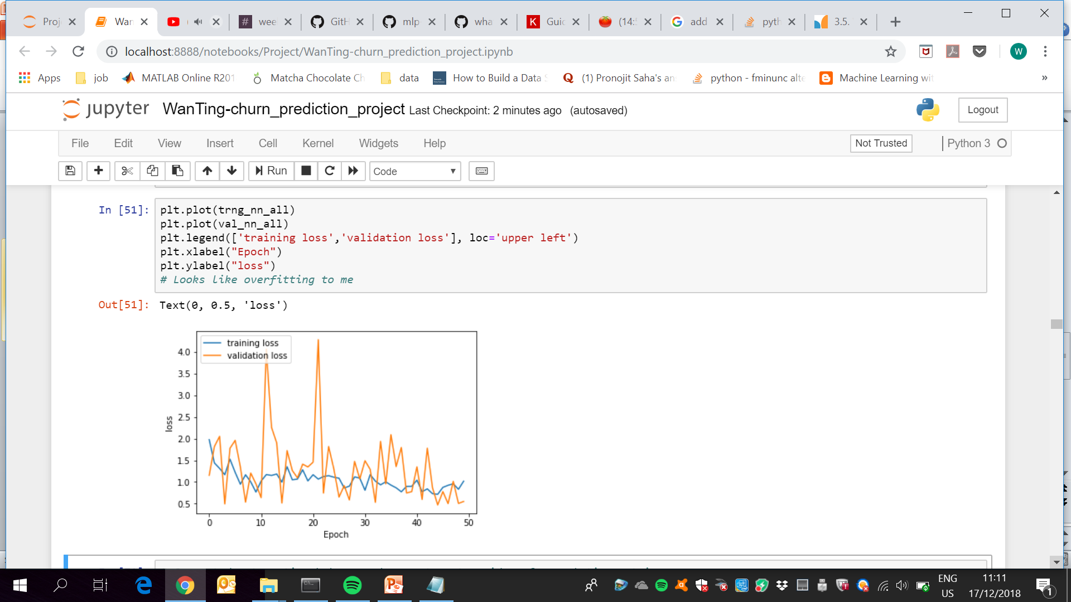
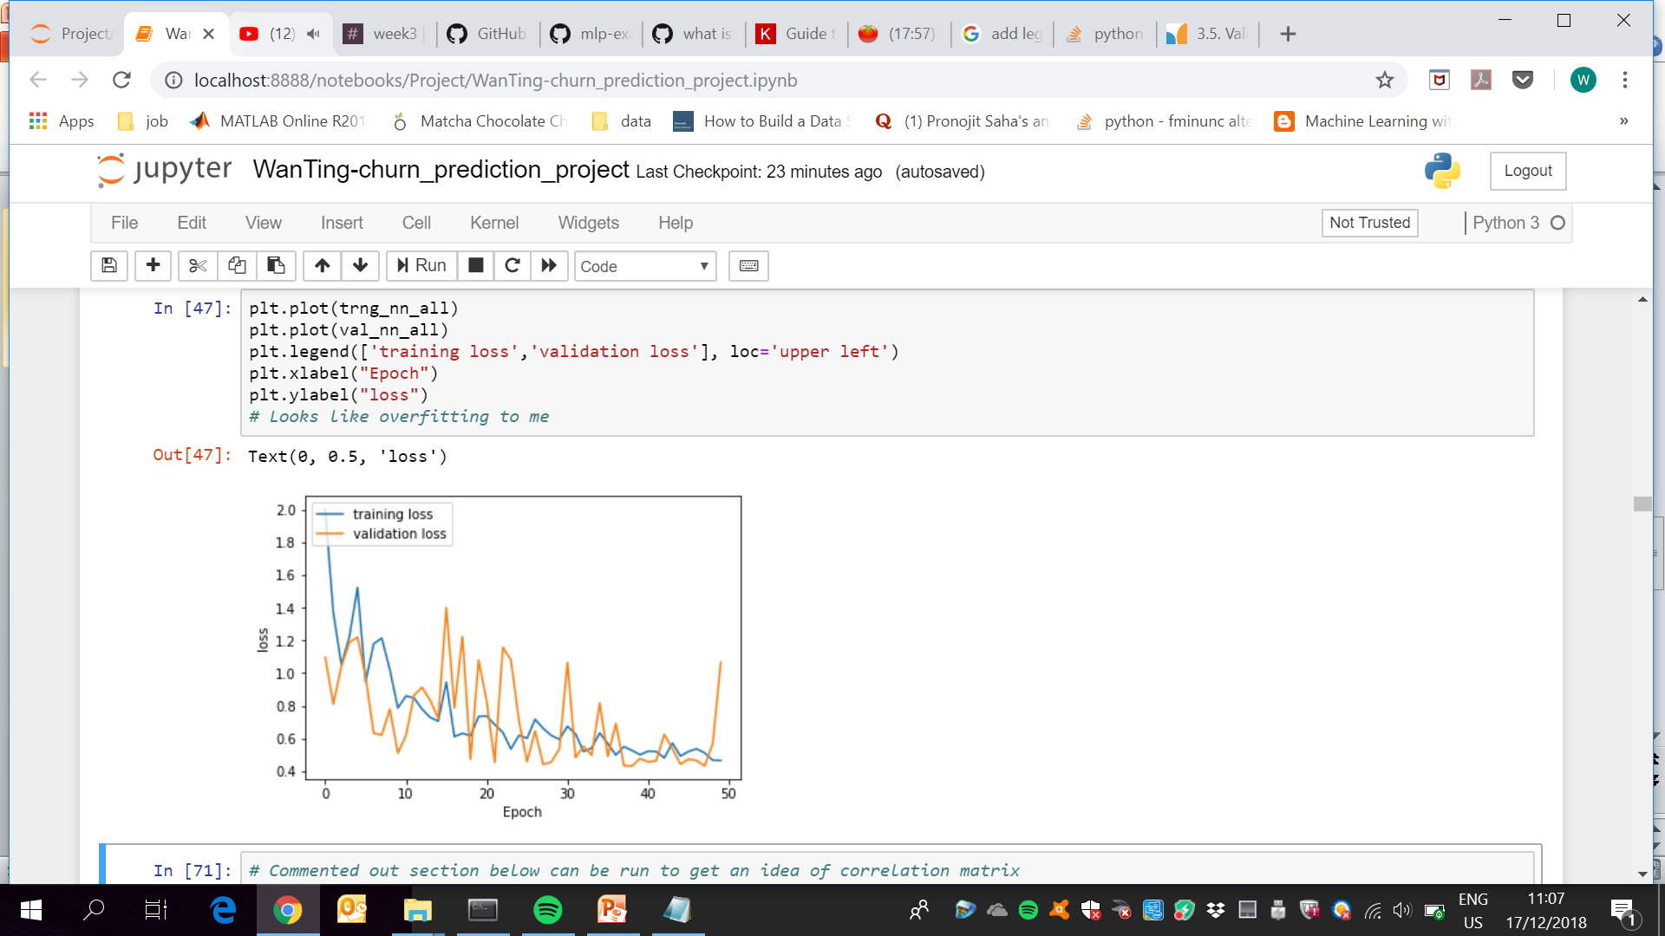
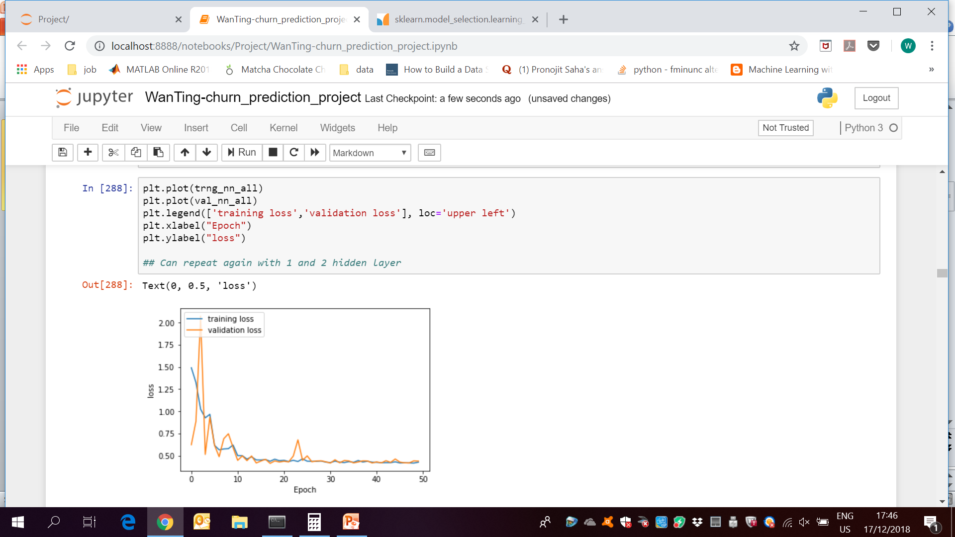
Neural Network (MLP)
Using full dataset with all 40 features
1 hidden layer with 20 neurons
2 hidden layers with 20 neurons
3 hidden layers with 20 neurons

Slide 6
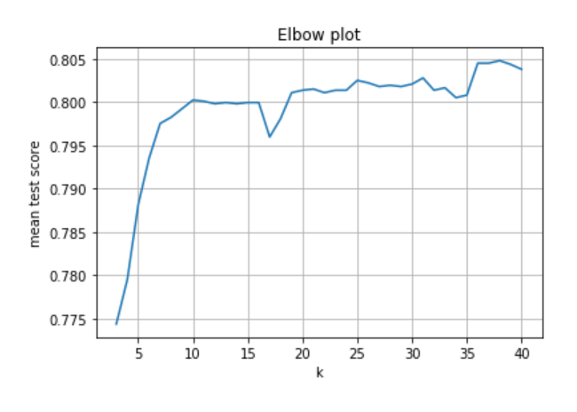
Feature Engineering
Used GridSearchCV to find best k for SelectKBest
Selected k=10
Features reduced from 40 to 10

Slide 7
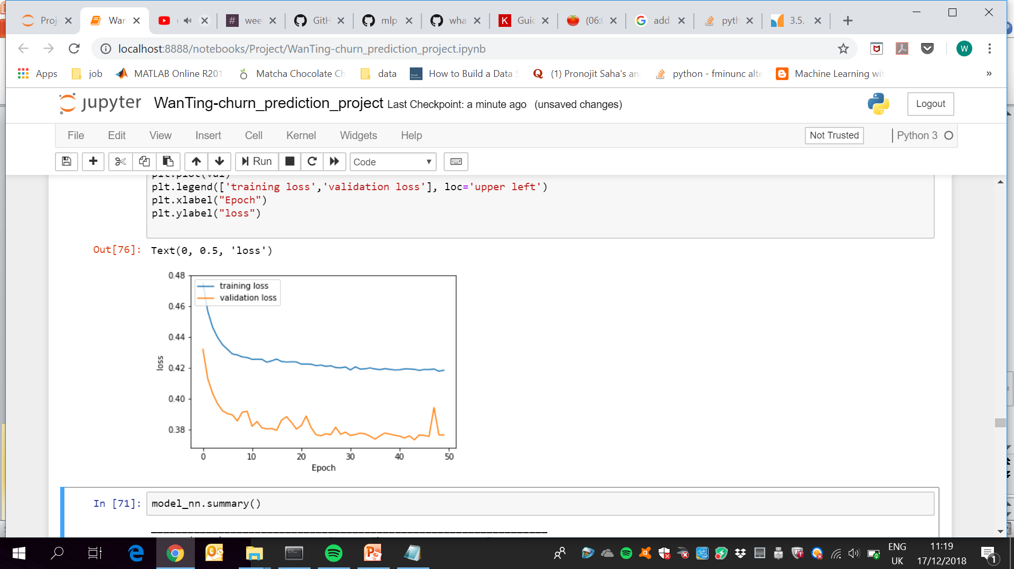
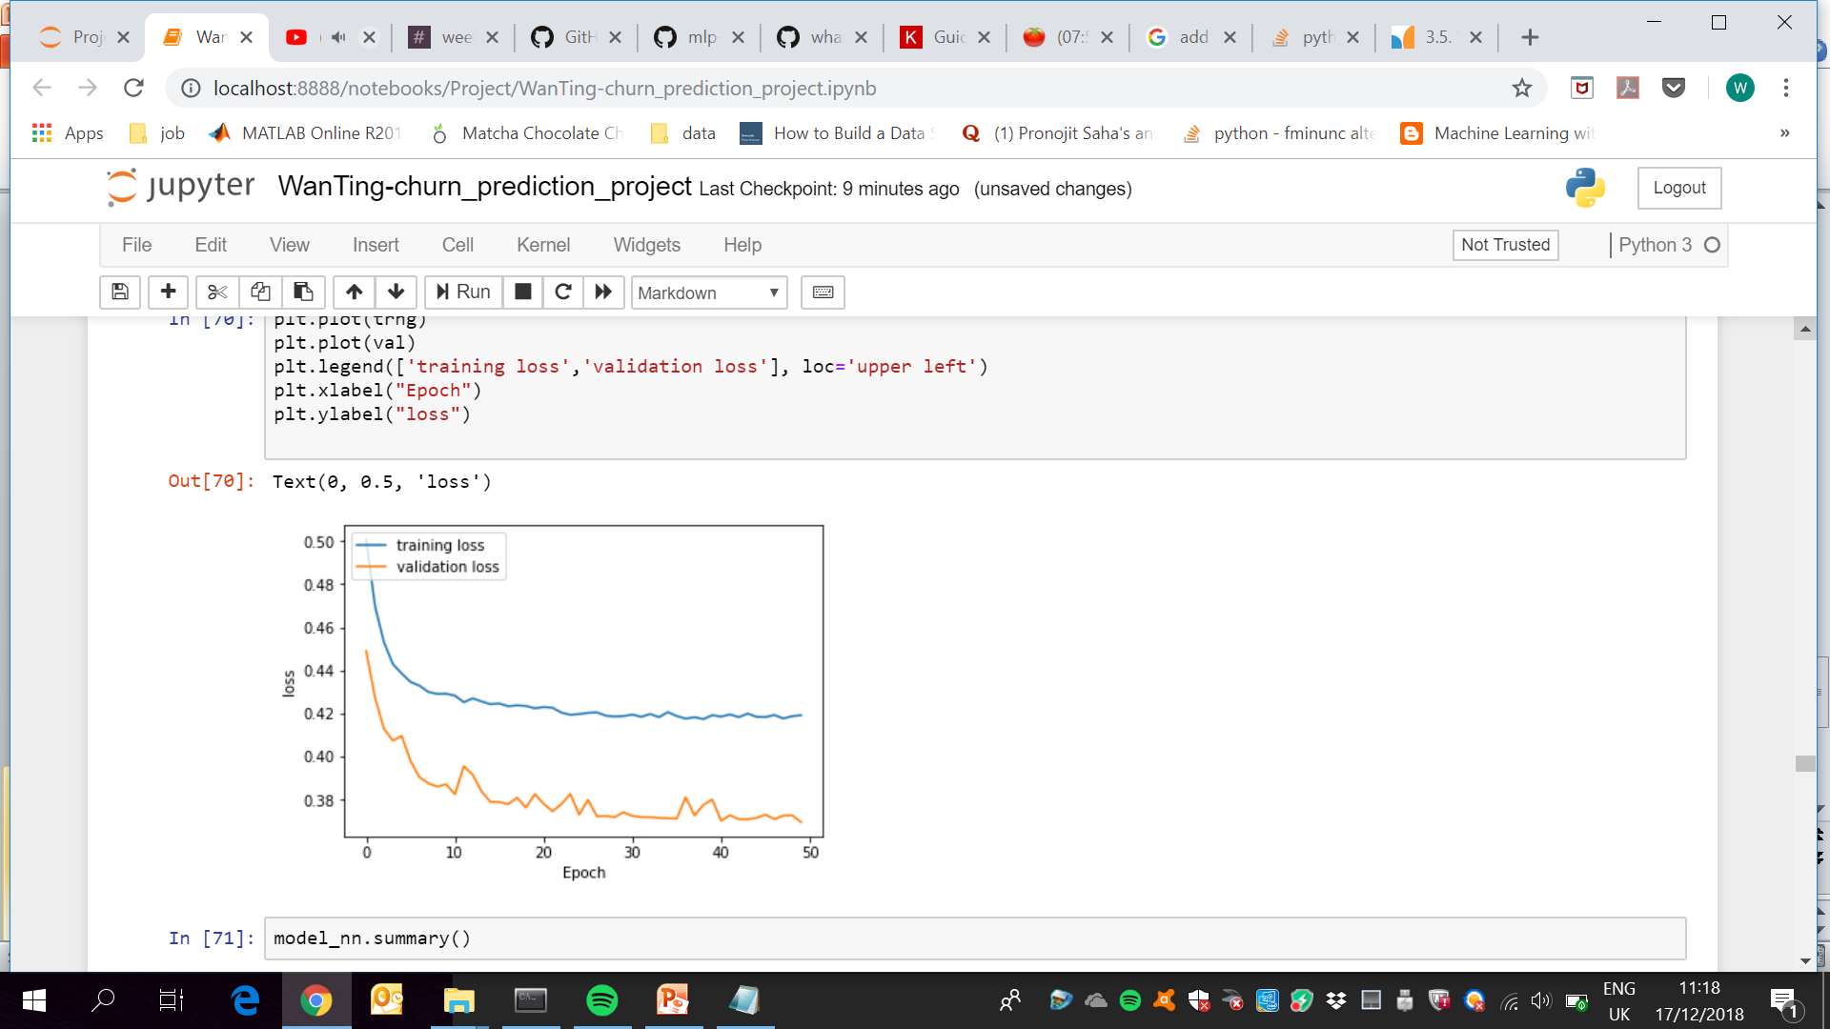
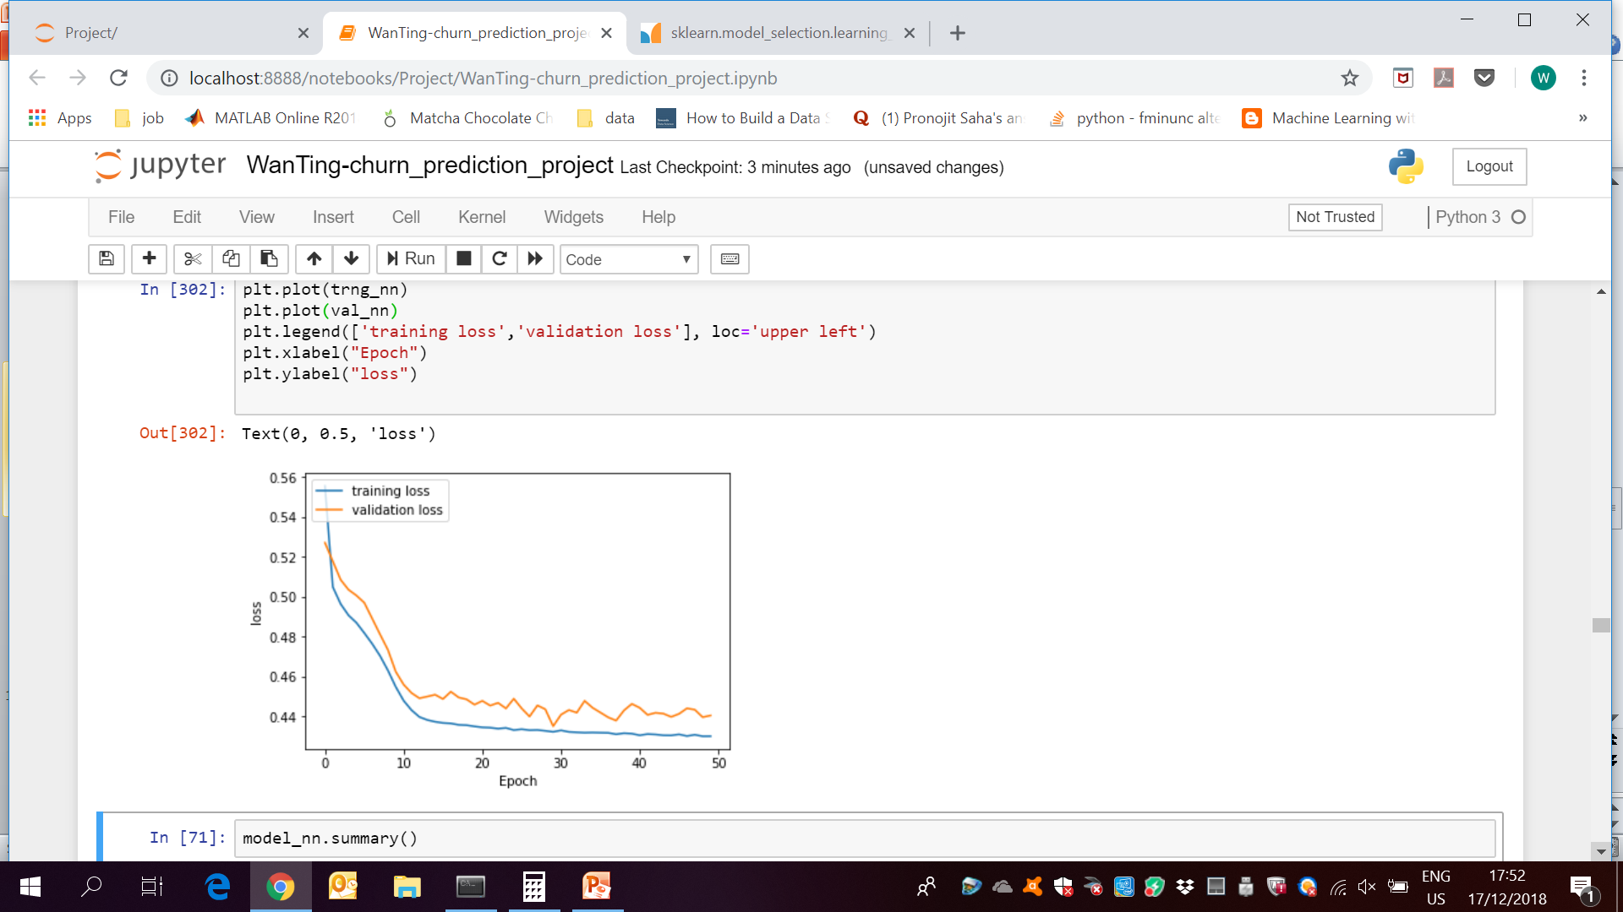
Neural Network (MLP)
Using reduced dataset with 10 features
1 hidden layer with 5 neurons
2 hidden layers with 5 neurons
3 hidden layers with 5 neurons

Slide 8
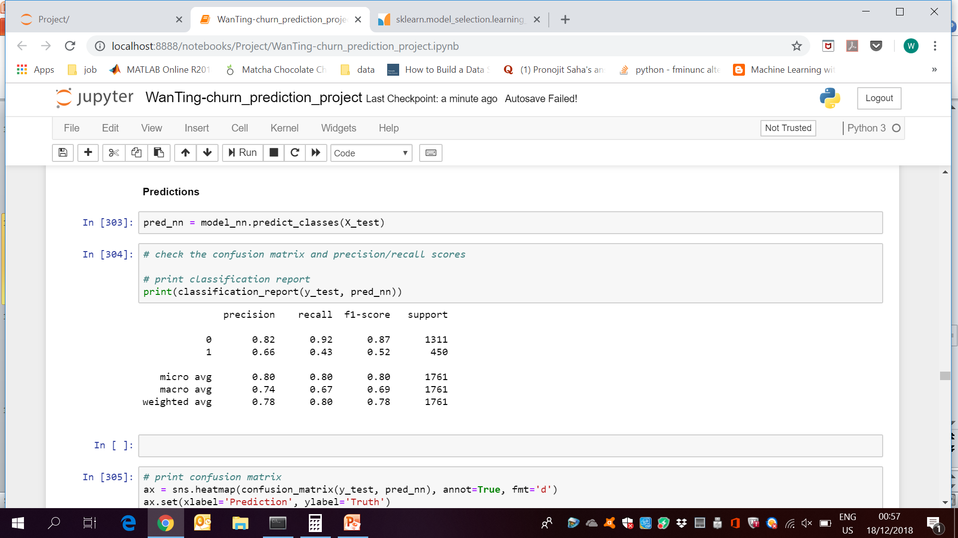
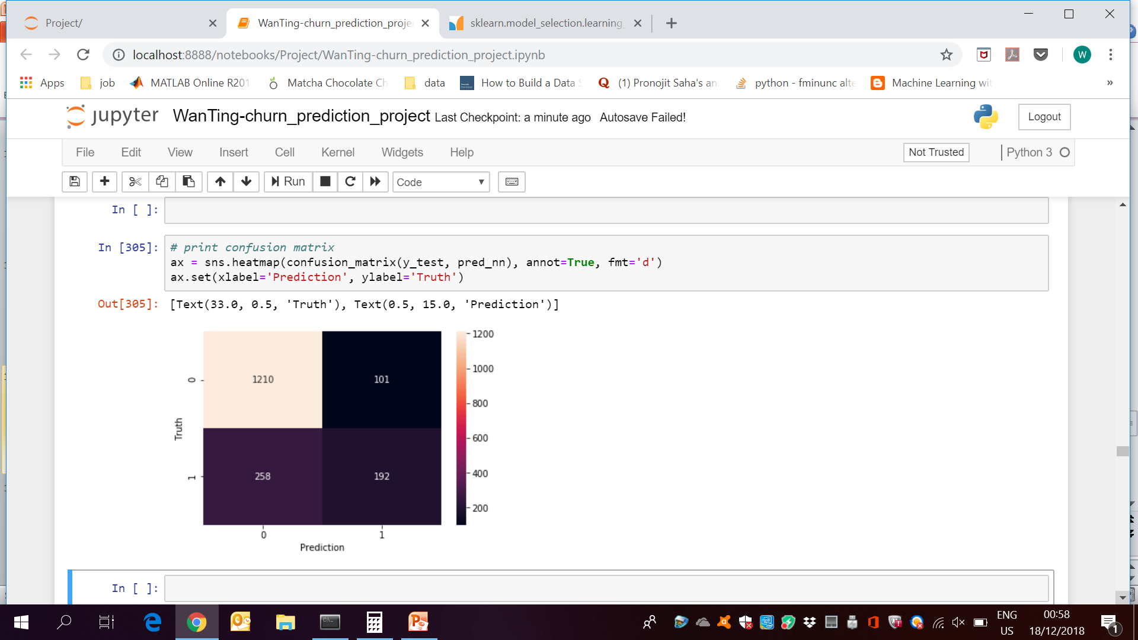
Evaluation
Neural Network (using reduced features, 3 hidden layers, 5 neurons each)
Classification report:
Confusion matrix:

Slide 9
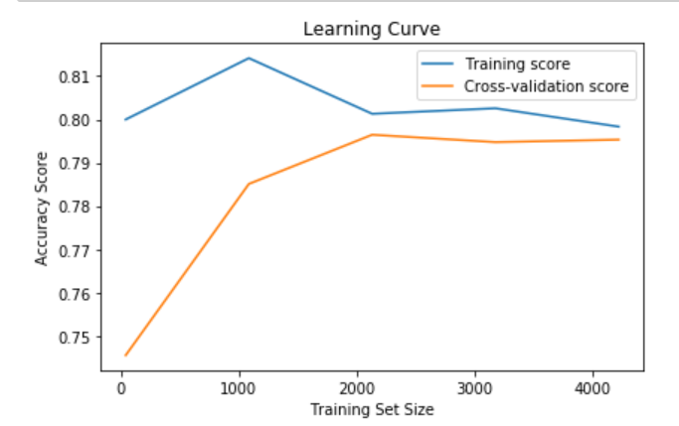
SVC classifier
Plot learning curve with x-axis as training set size
Purpose is to check model and not to determine training set size.
Overall, the model is acceptable and not over or underfitting

Slide 10
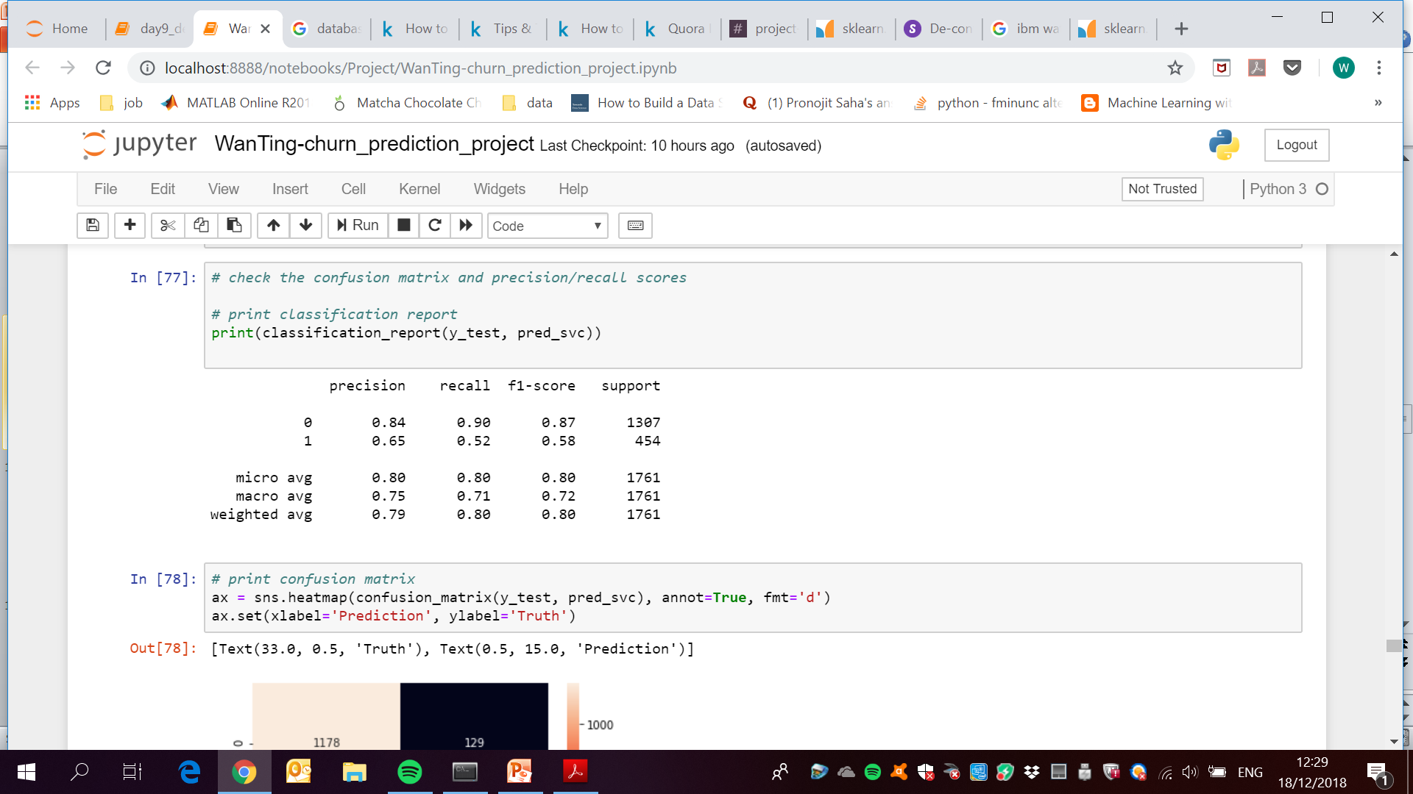
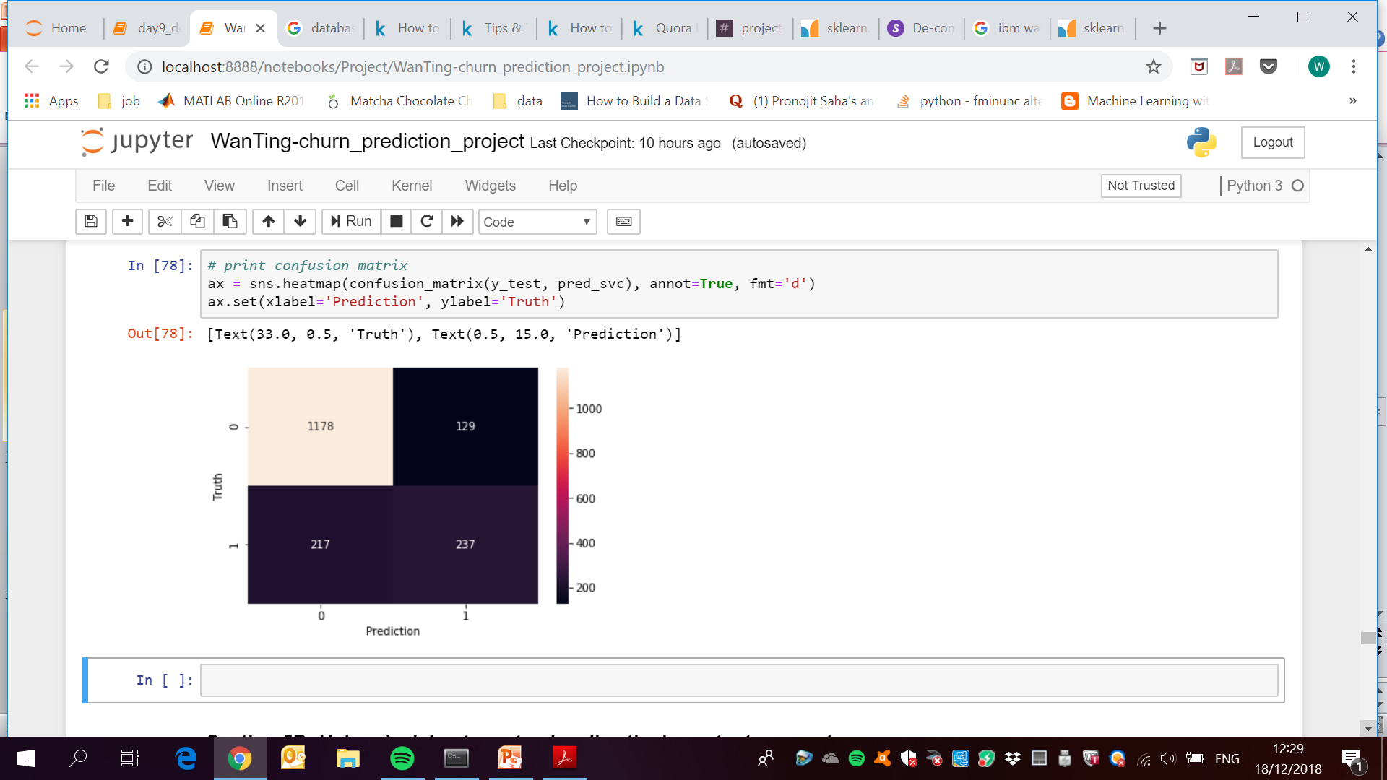
Evaluation
SVC classifier with C=1, gamma=0.1 (best params)
Classification report:
Confusion matrix:

Slide 11
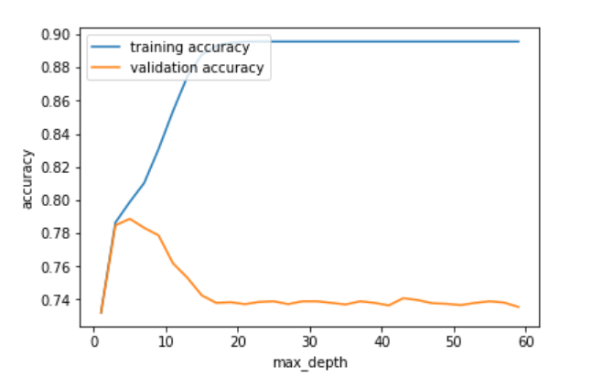
DTC
Plot learning curve with x-axis as max_depth
Selected max_depth = 5

Slide 12
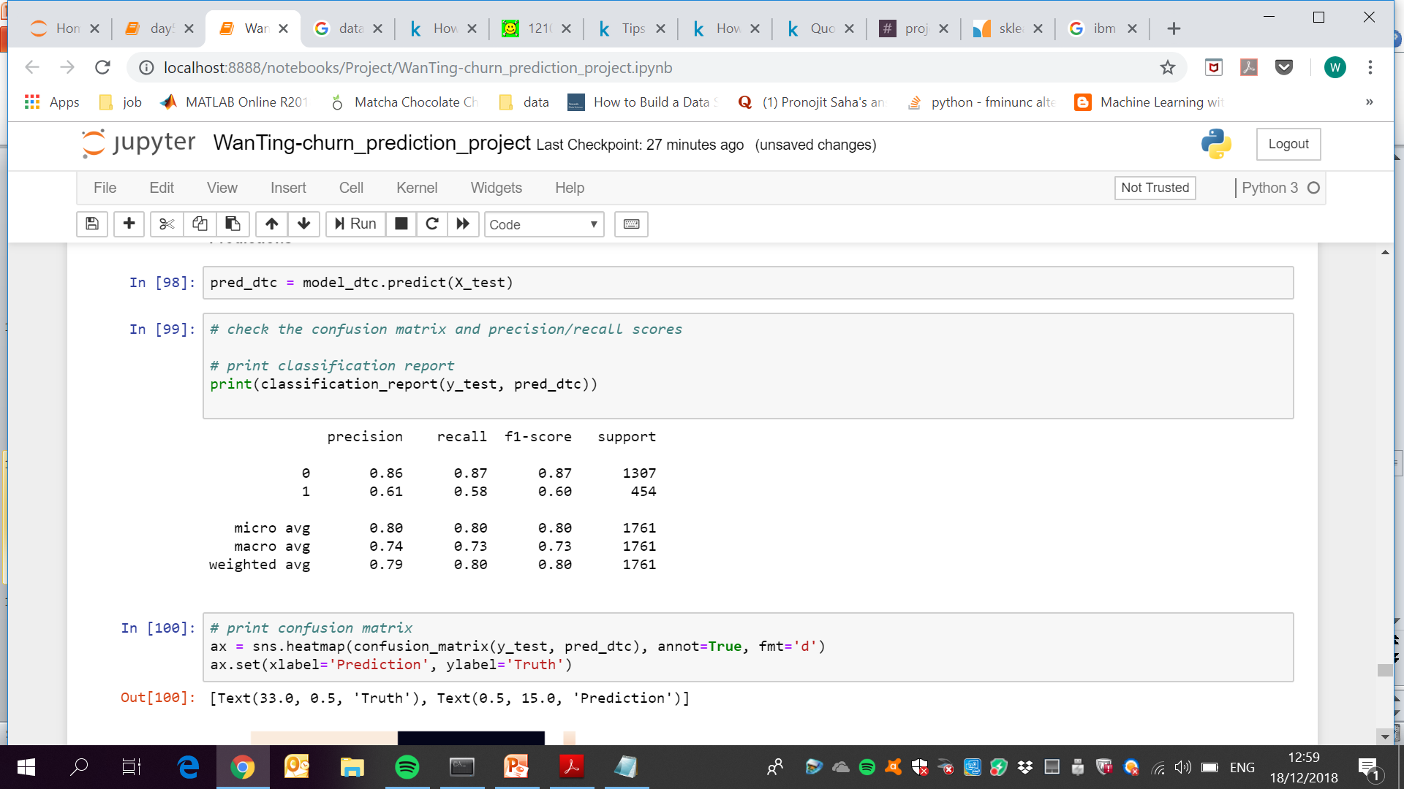
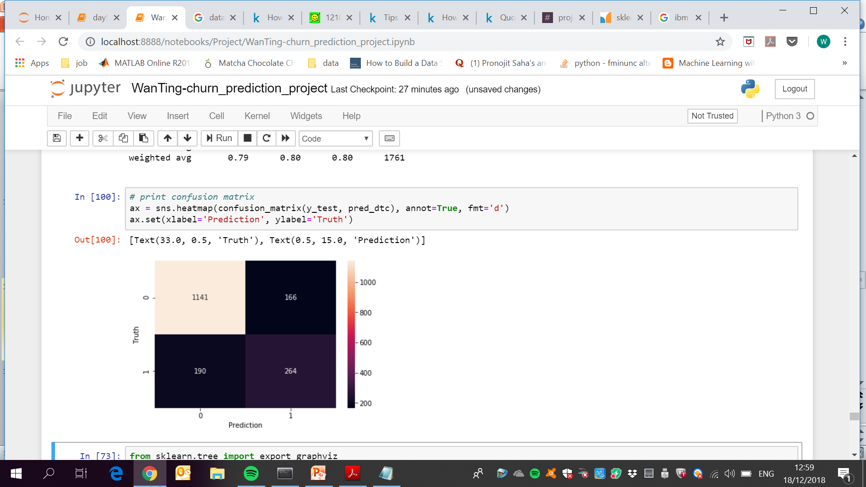
Evaluation
DTC classifier (max_depth = 5)
Classification report:
Confusion matrix:

Slide 13
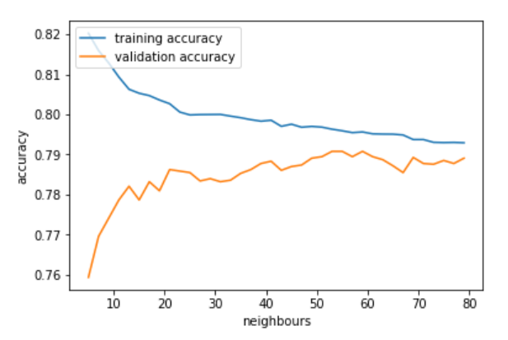
KNN
Plot learning curve with x-axis as n_neighbors
Selected n_neighbors=30

Slide 14
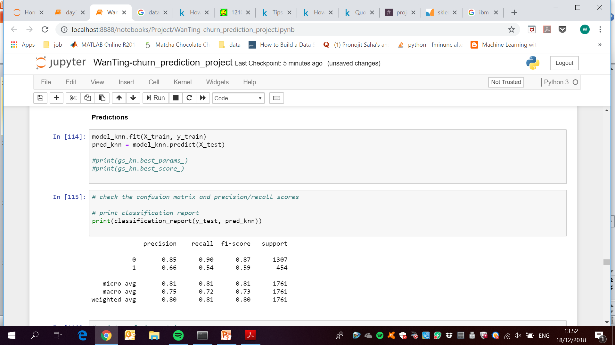
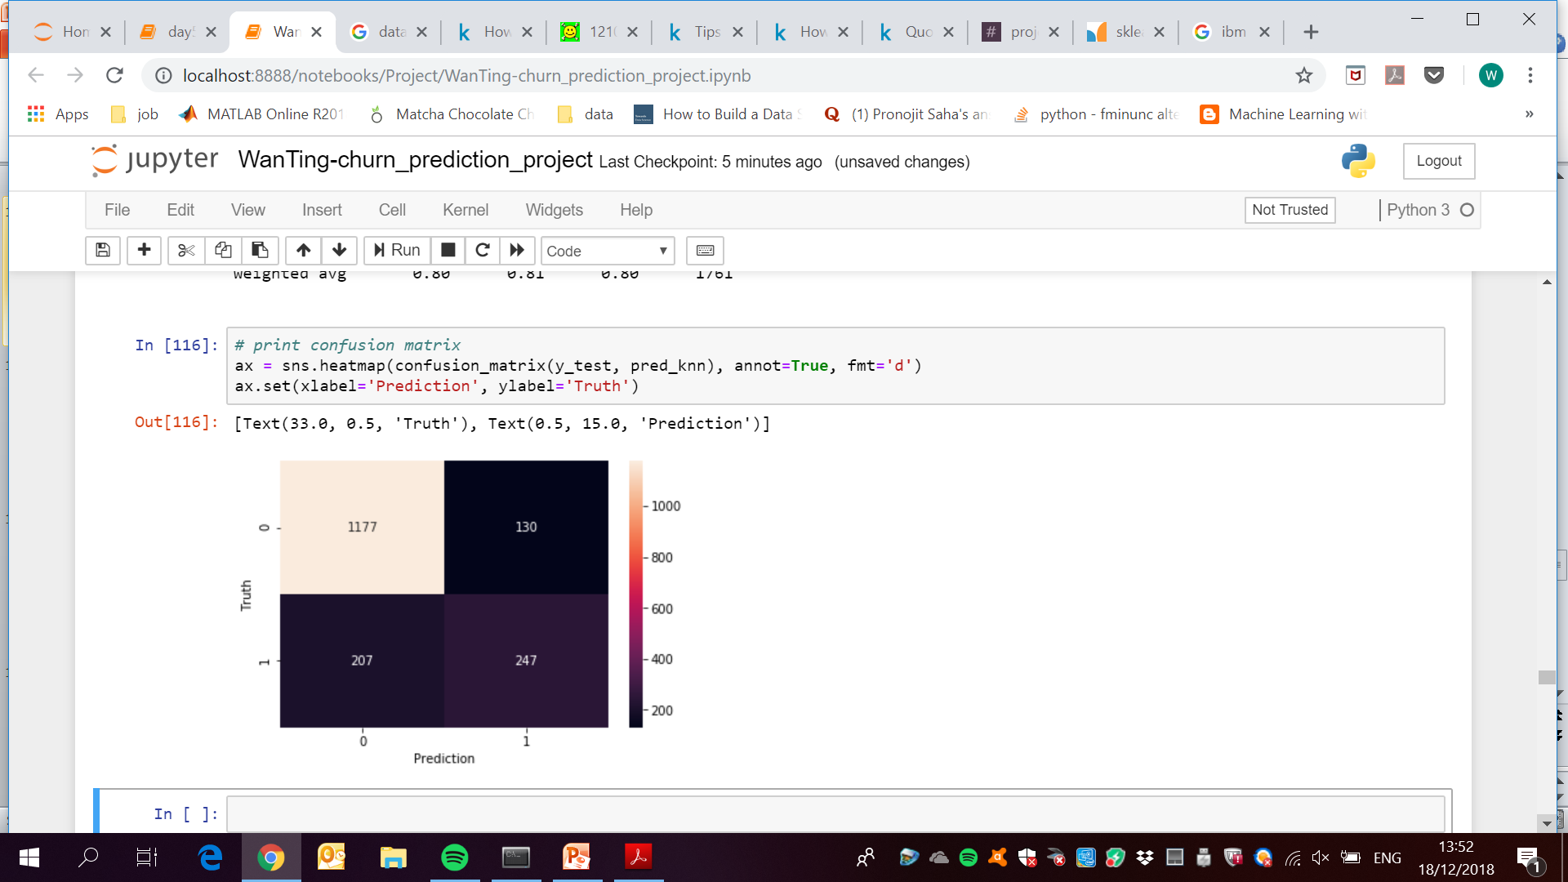
Evaluation
KNN with n_neighbors=30
Classification report:
Confusion matrix:

Slide 15
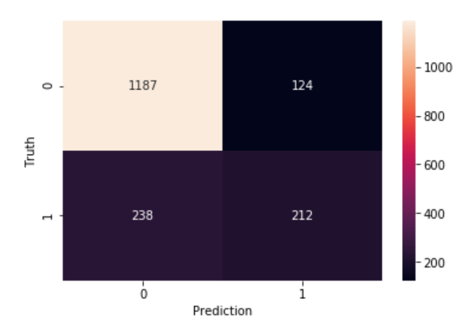
Conclusion
Overall, the models all work similarly
Work well to predict non-churn but not so good for churn
Since our objective is to target the churn customers, we want to reduce the cases where customer is 1 [positive, churn] but predicted as 0 [negative, non-churn]
Can have some leeway
Reduce this section

Slide 16
Neural Network (reduced features, 3 hidden layers, 5 neurons each)
SVC classifier with C=1, gamma=0.1
Lowest FN
DTC classifier with max_depth = 5
KNN with n_neighbors=30

Slide 17
Conclusion
So far, DTC works the “best” (lowest false negative)
However as all the models seem pretty similar, further tuning could be done for the other models as well to achieve lesser false negative.
Can have some leeway
Reduce this section

